Slide 1
Lecture X. Network Security Exercises ANS
CSC175
Notes:
Slides template credit: Josh Hug, Lisa Yan
today is the second half of the TCP implementation lecture and we're
0:45
going to take what we saw last time the ideas that we Ed to design reliability
0:50
and we're going to formalize them into an actual protocol
And if we have time we might also do some congestion control to get ahead on that

Slide 2
Block Cipher
Consider the 3-bit block cipher in the Table below
Plain | 000 | 001 | 010 | 011 | 100 | 101 | 110 | 111
Cipher | 111 | 110 | 101 | 100 | 011 | 010 | 000 | 001
Suppose the plaintext is 100101100.
Initially assume that CBC is not used. What is the resulting ciphertext?
Suppose Trudy sniffs the ciphertext. Assuming she knows that a 3-bit block cipher without CBC is being employed (but doesn’t know the specific cipher), what can she infer?
Now, suppose that CBC is used with IV-111. What is the resulting ciphertext?

Slide 3
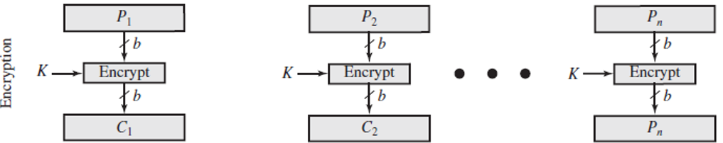
Block Cipher ANS
Plain | 000 | 001 | 010 | 011 | 100 | 101 | 110 | 111
Cipher | 111 | 110 | 101 | 100 | 011 | 010 | 000 | 001
Initially assume that CBC is not used. What is the resulting ciphertext?
ANS: Ciphertext for plaintext 100101100 is 011010011, since 100 maps to 011, 101 maps to 010, 100 maps to 011
(b) Suppose Trudy sniffs the ciphertext. Assuming she knows that a 3-bit block cipher without CBC is being employed (but doesn’t know the specific cipher), what can she infer?
ANS: Without CBC, each identical plaintext block will always map to the same ciphertext block. This makes it easier for Trudy to recognize patterns in repeated blocks of data. If Trudy intercepts enough ciphertexts, she could perform frequency analysis on the blocks. For example, if certain ciphertext blocks appear more frequently, she might guess that they correspond to more common plaintext blocks (like spaces or common letters in text). Or if it is known that the message always starts out with certain predefined fields, then the cryptanalyst may have a number of known plaintext-ciphertext pairs to work with.
(c) Now, suppose that CBC is used with IV=111. What is the resulting ciphertext?
ANS: With CBC and IV = 111, resulting ciphertext for plaintext 100101100 is 100110101. (See next page.)
100
101
100
011
010
011
The same plaintext 100 is encrypted into the same cyphertext (011) at different positions in the input, making it possible to attacker to perform frequency analysis.
Notes:
Let's break down the problem step by step based on the information provided in the table and the questions asked.
### Given:
- The 3-bit block cipher is represented as a mapping between plaintext and ciphertext:
$$
\begin{array}{|c|c|}
\hline
\text{Plaintext} & \text{Ciphertext} \\
\hline
000 & 110 \\
001 & 111 \\
010 & 101 \\
011 & 100 \\
100 & 011 \\
101 & 010 \\
110 & 000 \\
111 & 001 \\
\hline
\end{array}
$$
### (a) **Without CBC: What is the resulting ciphertext for the plaintext `100101100`?**
The plaintext `100101100` is a sequence of 9 bits, which we can divide into three 3-bit blocks:
- First block: `100`
- Second block: `101`
- Third block: `100`
Using the table provided, we can map each block of plaintext to its corresponding ciphertext:
- `100` maps to `011`
- `101` maps to `010`
- `100` maps to `011`
Thus, the resulting ciphertext is the concatenation of these three ciphertext blocks:
$$
\text{Ciphertext} = 011010011
$$
### (b) **What can Trudy surmise if she sniffs the ciphertext and knows a 3-bit block cipher without CBC is being used?**
If Trudy intercepts the ciphertext but does not know the specific cipher being used, she can infer certain things based on her knowledge of how block ciphers work:
1. **Block Size**: Since she knows it's a 3-bit block cipher, she can deduce that each group of 3 bits in the intercepted ciphertext corresponds to one block of plaintext.
2. **Frequency Analysis**: If Trudy intercepts enough ciphertexts, she could perform frequency analysis on the blocks. For example, if certain ciphertext blocks appear more frequently, she might guess that they correspond to more common plaintext blocks (like spaces or common letters in text).
3. **No CBC Weakness**: Without CBC (Cipher Block Chaining), each identical plaintext block will always map to the same ciphertext block. This makes it easier for Trudy to recognize patterns in repeated blocks of data.
However, without knowing the specific mapping between plaintext and ciphertext, Trudy cannot directly decrypt the message unless she somehow discovers or guesses this mapping.
### (c) **With CBC and IV = 111: What is the resulting ciphertext for the plaintext `100101100`?**
When CBC (Cipher Block Chaining) is used, each plaintext block is XORed with the previous ciphertext block (or with the Initialization Vector (IV) for the first block) before being encrypted.
1. **IV = 111**: The first step is to XOR the first plaintext block with the IV.
- First plaintext block: `100`
- IV: `111`
- XOR result: $$ 100 \oplus 111 = 011 $$
Now we encrypt this result (`011`) using our cipher table:
- `011` maps to `100`.
So, the first ciphertext block is `100`.
2. **Second Block**: Now we XOR the second plaintext block with the first ciphertext block:
- Second plaintext block: `101`
- First ciphertext block: `100`
- XOR result: $$ 101 \oplus 100 = 001 $$
Now we encrypt this result (`001`) using our cipher table:
- `001` maps to `111`.
So, the second ciphertext block is `111`.
3. **Third Block**: Finally, we XOR the third plaintext block with the second ciphertext block:
- Third plaintext block: `100`
- Second ciphertext block: `111`
- XOR result: $$ 100 \oplus 111 = 011 $$
Now we encrypt this result (`011`) using our cipher table:
- `011` maps to `100`.
So, the third ciphertext block is `100`.
Thus, when using CBC with IV = 111, the resulting ciphertext is:
$$
\text{Ciphertext} = 100111100
$$
### Final Answer Summary:
- **(a)** Without CBC, resulting ciphertext for plaintext `100101100`:
$$ \text{Ciphertext} = 011010011 $$
- **(b)** Trudy can infer that it's a 3-bit cipher and may use frequency analysis but cannot directly decrypt without knowing the specific mapping.
- **(c)** With CBC and IV = 111, resulting ciphertext for plaintext `100101100`:
$$ \text{Ciphertext} = 100111100 $$
Citations:
[1] https://ppl-ai-file-upload.s3.amazonaws.com/web/direct-files/657250/670d6e33-bf04-4786-8da4-9b8cff7bf69b/Temp.pdf

Slide 4
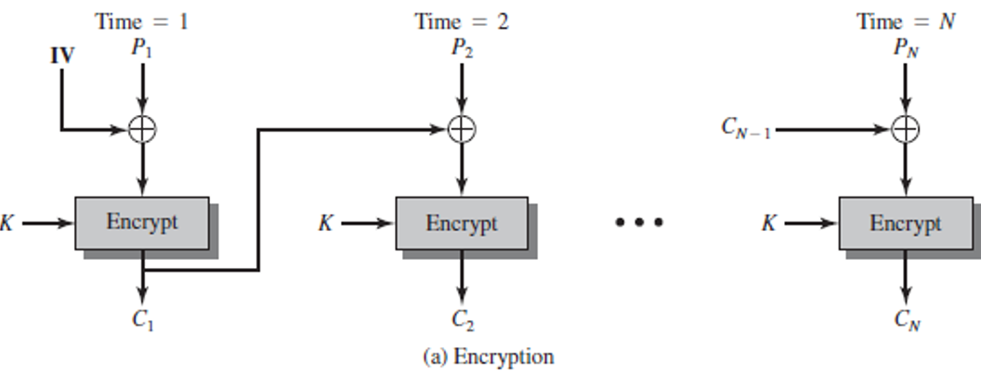
Block Cipher ANS
Plain | 000 | 001 | 010 | 011 | 100 | 101 | 110 | 111
Cipher | 111 | 110 | 101 | 100 | 011 | 010 | 000 | 001
Plaintext 100101100
The first step is to XOR the first plaintext block with IV = 111
First plaintext block: 100, so 100⊕111=011
Now we encrypt this result (011) using our cipher table: 011 maps to 100.
Second Block: Now we XOR the second plaintext block with the first ciphertext block:
Second plaintext block: 101, so 101⊕100=001
Now we encrypt this result (001) using our cipher table: 001 maps to 110.
Third Block: Finally, we XOR the third plaintext block with the second ciphertext block:
Third plaintext block: 100, so 100⊕110=010
Now we encrypt this result (010) using our cipher table: 010 maps to 101.
Resulting ciphertext for plaintext 100101100 is 100110101.
111
100
101
110
100
011
001
010
100
110
101
The same plaintext 100 is encrypted into different cyphertexts (100 or 101) at different positions in the input, thanks to CBC.

Slide 5
Diffie-Hellman
Suppose Alice and Bob wish to do Diffie-Hellman key exchange. Alice and Bob have agreed upon a prime p = 13, and a generator g = 2. Alice has chosen her secret number (private exponent) to be a = 5, while Bob has chosen his private exponent to be b = 4.
Show the intermediate quantities that both Alice and Bob calculate, as well as the final (shared) secret that Diffie-Hellman produces.

Slide 6
Diffie-Hellman ANS
Suppose Alice and Bob wish to do Diffie-Hellman key exchange. Alice and Bob have agreed upon a prime p = 13, and a generator g = 2. Alice has chosen her secret number (private exponent) to be a = 5, while Bob has chosen his private exponent to be b = 4.
Show the intermediate quantities that both Alice and Bob calculate, as well as the final (shared) secret that Diffie-Hellman produces.
ANS: Alice sends to Bob: A=g^a mod p= 2^5 mod 13 = 6.
Bob computes the secret: S=A^b mod p = 6^4 mod 13 = 1296 mod 13 = 9.
Bob sends to Alice B=g^b mod p = 2^4 mod 13 = 3.
Alice computes the secret: S=B^a mod p = 3^5 mod 13 = 243 mod 13 = 9.

